Slide 1

Earlybird 2020
Team Falcons
“Following Emergencies”
Notes:
Abdi, Amanda, Charles, Carlos, Caro, Larissa, Aymen

Slide 2

Agenda
1
2
3
4
5
6
Intro
Goal
Process
Planning & Design
Demo
Thank You and Questions
Notes:
Aymen:
Through our presentations we will be introducing you to what we will be presenting, followed by our goals for what we want our feature to target. Then we will show you guys our process of how we came up with the feature, and how we implemented it. We will then show you guys a demo to explain the features and finally answer any lingering questions you guys may have since I am sure you guys are so interested in it that you’ll have many burning questions!

Slide 3

Intro
Notes:
Abdi
Introduction of Emergency Tweets: Twitter represents “what’s happening”, therefore it’s essential for this platform to show it’s concerns about current events by raising awareness to emergency causes

Slide 4

Goals
#Goal
#Goal
#TwitterPrinciples
Why is our feature valuable to the platform?
“Helping people find reliable information, connect with others, and follow what’s happening in real time.”- Twitter Blog
Allows people to be notified about information regarding such tweets.
How do “Emergency Tweets” help Twitter?
Bring more users to Twitter increasing DAU and MAU.
Notifications increases DAM (daily active minutes)
This will increase the amount of times people will see ads, therefore making more money for Twitter.
What Twitter Principles Does It Align With?
#trust
#health
#straightforward
#purpose
#fast
#free
Notes:
(Amanda, Aymen)
Emergency notifications will make users spend more time on the platform (DAM) bc it increases how many times a user open the app daily -> increases chances of seeing adds
Aymen: Twitter goals and how it relates
#trust: twitter trustworthy source of min-to-min news
#health: raising awareness about health-related emergencies promotes health
#straightforward: design and purpose simple and understandable even to people who don’t see feature announcement
#purpose #fast #free: purpose is to raise awareness as #fast as possible. is also #free.
pass it over to charles

Slide 5

Process
Notes:
(Charles)

Slide 6
Planning
Brainstorm! Brainstorm! Brainstorm!
Mentor Feedback
Result: “Emergencies” implementation would be amazing.
Design
We analyzed further by editing HTML in Twitter Web’s UI and looking for how we could add our feature to the “Tweet Detail” section.
Features Added:
“Follow Emergency” button and flashing warning sign.
Added the special feed button for emergencies only
Roadblock: Getting our feature to fit with the Twitter aesthetics.
Notes:
(Charles, Carlos))
(How did your team build the feature? How many iterations? Define roadblocks, successes and lessons learned. Explain the user experience. )
We had to add a button, a hover sign, changes in the button of follow when you press it one time and again, and the sign that appears after you click it. We had an approximation of 4 iterations in our way to add the final features. One of our roadblocks was to follow the Twitter aesthetics trying to make the feature as they belong in the page. We really had a huge success adding the feature and their reactions with the signs. We learn a lot about how Twitter is made, how to add some features in a page, use json to stock data. *There is left the user experience*

Slide 7
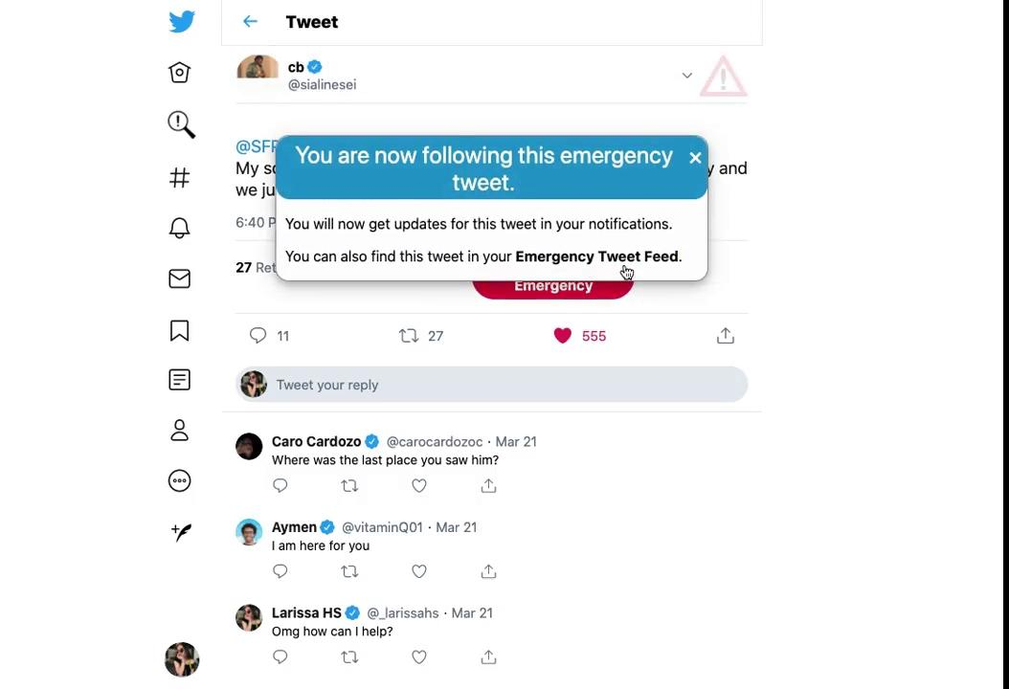
Demo
Notes:
Larissa - Emergency Icon
Carol - Following Option

Slide 8
Emergency Tweet
About
“Emergency Tweet” option for tweets containing concerning topics would highlight the tweet on both the feed and in the tweet detail section.
There is also a section in the left where it will be all the emergency tweets, like a feed for emergency..
How it works
Emergency tweets are marked with a flashing icon to catch the users attention
Upon opening an emergency tweet, there will be an option to follow that tweet (via a button) so that users can stay posted on the latest updates.
Use Case: Missing Person
Notes:
(Larissa)
We are introducing the emergency tweet option. An emergency icon at the top right of the tweet would highlight it as a concerning topic. Hovering over the icon will give a bit of detail on what icon is representing.
After following it, notifications regarding the emergency topic will be sent
All the tweets can be marked as an emergency tweet with a button in the redaction area, it will pass to a filter to check if it really and emergency, and when the tweets are in the feed you can report if it’s not or otherwise notify that it’s actually an emergency. You can also add pictures too.

Slide 9
Follow Option
About
The “follow” feature would be exclusive to “emergency tweets” upon launch, but if found successful in other contexts, the “follow” feature could be extended to those too.
How it works
Option to follow tweet/thread (via button-click)
Following will allow post notifications for the designated emergency tweet regarding new information
You can unfollow by going to same tweet and click it one more time
Use Case: Hospitals Requesting Personal Protective Equipment
Notes:
(Caro) After the user clicks the “Follow Emergency” button, they will receive updates on every new information about the tweet, for example, with the case of a missing person, they would be notified where they were last seen, whether they have been found, etc.
In this example it is the case of a hospital out of stock of medical mask so you can follow the tweet to know the updates of the case, because maybe there someone that can help for example the comment of Larissa saying she know a association that can help.Also if you want to stop receiving notification you can unfollow by pressing the same button.
If the feature have successful in this context, this function can be used in forward projects like following a threat that you are interested in.

Slide 10

Thank You

